Slide 1
LEMS-A3
David Mayo
dcmayo@moreheadstate.edu
MSU ACM
2025-08-28

Slide 2
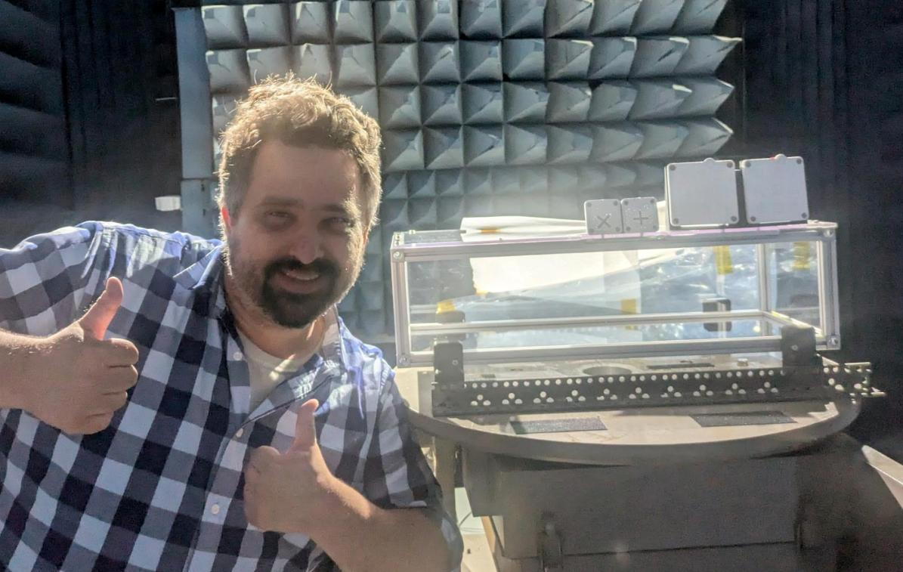
Lunar Environment Monitoring Station for Artemis III
Who am I?
David Mayo
dcmayo@moreheadstate.edu
Space Science Center Research Engineer
MSU computer science class of 2022
Working on NASA’s LEMS-A3 mission

Slide 3
Lunar Environment Monitoring Station for Artemis III
What is LEMS-A3?
The Lunar Environment Monitoring Station for Artemis III (LEMS-A3) is a compact, autonomous, and self-sustaining geophysical instrument package that enables multi-year, in-situ, monitoring of the Moon’s seismic environment.
– It is a self-powered, self-managed, and self-communicating flight system.
– It conducts science observations on the lunar surface continuously (day and night).

Slide 4
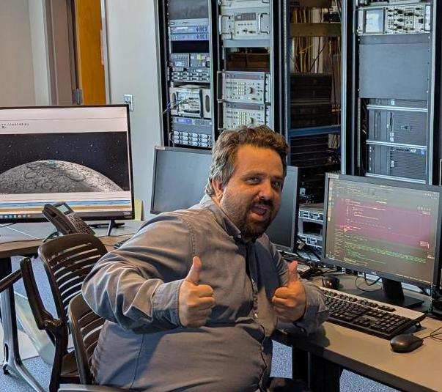
LEMS-A3 Mission Operations Center
Mission Operations Center (MOC)
This is my job!
The whole mission is going to be run from MSU
We need to write a whole bunch of code to make this happen:
GUI for monitoring spacecraft during communications sessions
File transfer to/from spacecraft
File transfer to/from NASA
Analyze spacecraft data
Analyze potential landing zones on moon
Validate spacecraft commands before testing
Buncha other stuff!

Slide 5
I need your help!
I (David Mayo, dcmayo@moreheadstate.edu) can hire intern(s) (unpaid), and potentially a student staff member (paid).
Requirements:
American citizen (non-negotiable)
Able to get to the Space Science Center in person
Can devote at least 5 hours (intern) or at least 10 to 20 hours (staff) a week
Pretty comfortable with Python
Nice to have:
Knowledge of Linux
Knowledge of Pandas/Numpy/MatPlotLib
Knowledge of git/GitHub
Probably at least a sophomore (intern) or junior (staff)

Slide 6


Padawan Palooza!

Slide 7

Questions?
David Mayo
Morehead State University
Space Science Center
Research Engineer
dcmayo@moreheadstate.edu
github.com/davidmayo
This presentation:
https://github.com/davidmayo/acm-2025

